Slide 1
Budget
UNION
2022-23

Slide 2
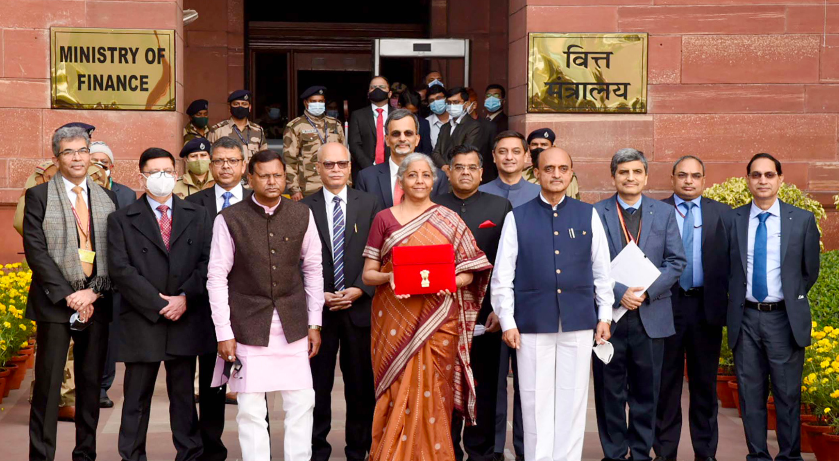
Overview of Union Budget 2022-23
The Union Budget of 2022-23 was presented by Finance Minister Smt. Nirmala Sitharaman on February 1, 2022. Infrastructure emerged as the topmost priority for the Narendra Modi government as the finance minister said that the Budget for 2022-2023 will lay the foundation for economic growth through public investment as Asia's third-largest economy emerges from a pandemic-induced slump.
The Finance Minister outlined the effects of the pandemic, saying the speed of vaccination had greatly helped in combating the pandemic.
“We are in the midst of the Omicron wave, the speed of our vaccination campaign has helped greatly. I am confident that with ‘Sabka Prayaas’ (everyone’s efforts) we'll continue with strong growth."
Notes:
https://indianexpress.com/article/business/union-budget-2022-live-updates-nirmala-sitharaman-modi-govt-7748785/
https://www.indiabudget.gov.in/doc/budget_speech.docx

Slide 3
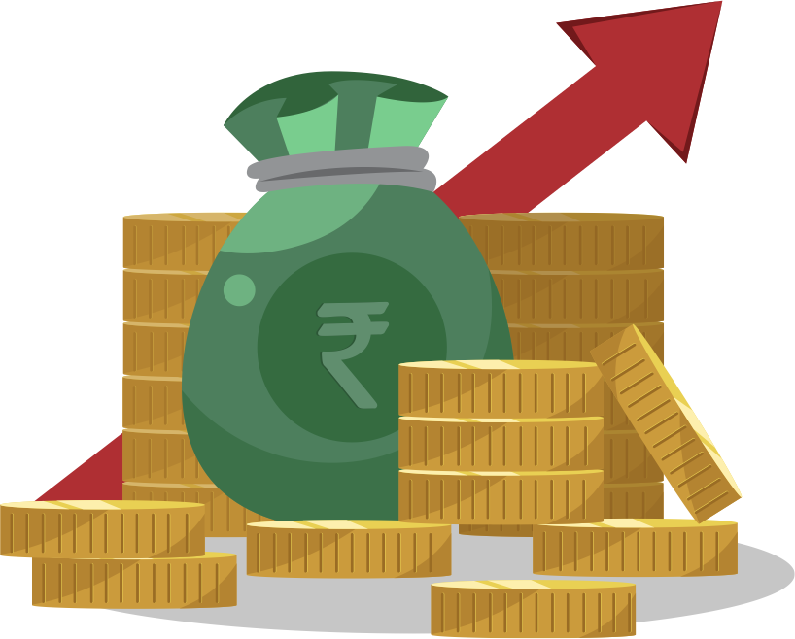
Key Highlights of the Budget
India’s economic growth is estimated at 9.2% to be the highest among all large economies
60 lakh (6 million) new jobs to be created under the productivity linked incentive scheme in 14 sectors
The outlay for capital expenditure stepped up sharply by 35.4% to INR 7.50 lakh crore (~US$ 106 billion) in 2022-23 from INR 5.54 lakh crore (~US$ 80 billion) in the current year.
The outlay in 2022-23 to be 2.9% of GDP
Effective Capital Expenditure of Central Government estimated at INR 10.68 lakh crore (US$ 147 billion) in 2022-23, which is about 4.1% of GDP.
PLI Schemes have the potential to create an additional production of INR 30 lakh crore (~US$ 401 billion)
1 USD = 74.7524 INR

Slide 4
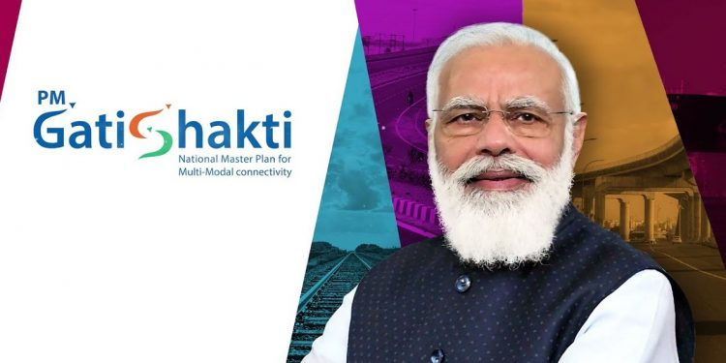
India@100
Entering Amrit Kaal - the 25 year-long lead up to India@100 - the budget provides the impetus for growth along with four priorities
PM Gatishakti
Productivity Enhancement and Investment, Sunrise Opportunities, Energy Transition and Climate Action
Inclusive Development for Aspirational India
Financing of Investments
The four pillars continue to build on the vision drawn in the Budget of 2021-22.

Slide 5
PM Gatishakti

Slide 6
PM Gatishakti
The seven engines that drive PM Gatishakti are Roads, Railways, Airports, Ports, Mass Transport, Waterways and Logistics Infrastructure.
PM Gatishakti National Master Plan:
This will encompass the seven engines for economic transformation, seamless multimodal connectivity and logistics efficiency.
The projects pertaining to these 7 engines in the National Infrastructure Pipeline will be aligned with the PM Gatishakti framework.

Slide 7
Road Transport
National Highways Network to be expanded by 25,000 Km in 2022-23
INR 20,000 Crore (~US$ 267 billion) to be mobilized for National Highways Network expansion
Multimodal Logistics Parks
Contracts to be awarded through PPP mode in 2022-23 for implementation of Multimodal Logistics Parks at four locations.

Slide 8
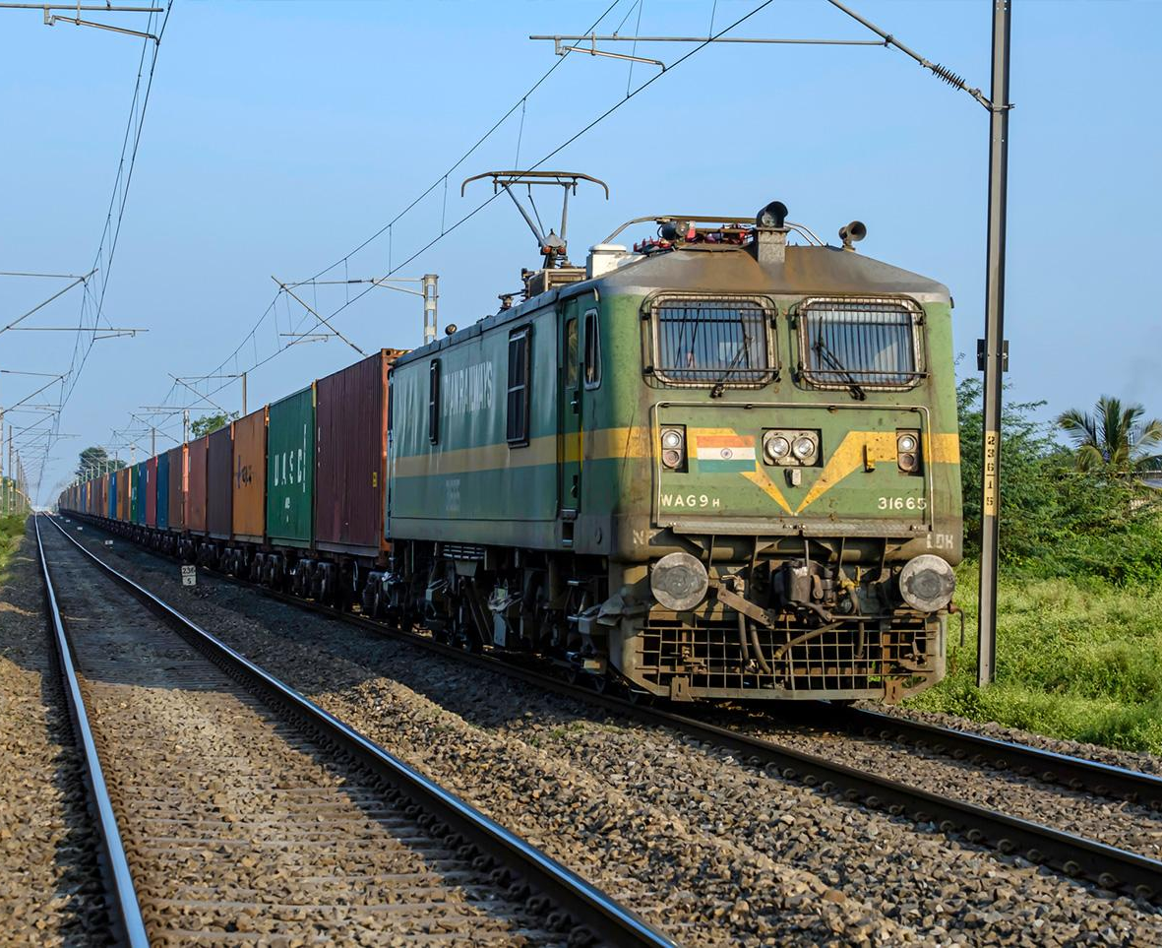
Railways
One Station One Product concept to help local businesses & supply chains.
2,000 Km of the railway network to be brought under Kavach (Armour), the indigenous world-class technology and capacity augmentation in 2022-23.
400 new generation Vande Bharat Trains to be manufactured during the next three years.
100 PM Gatishakti Cargo terminals for multimodal logistics to be developed during the next three years.
“400 new generation Vande Bharat trains with better efficiency to be brought in during the next 3 years; 100 PM Gatishakti Cargo terminals to be developed during next 3 years and implementation of innovative ways for building metro systems."

Slide 9
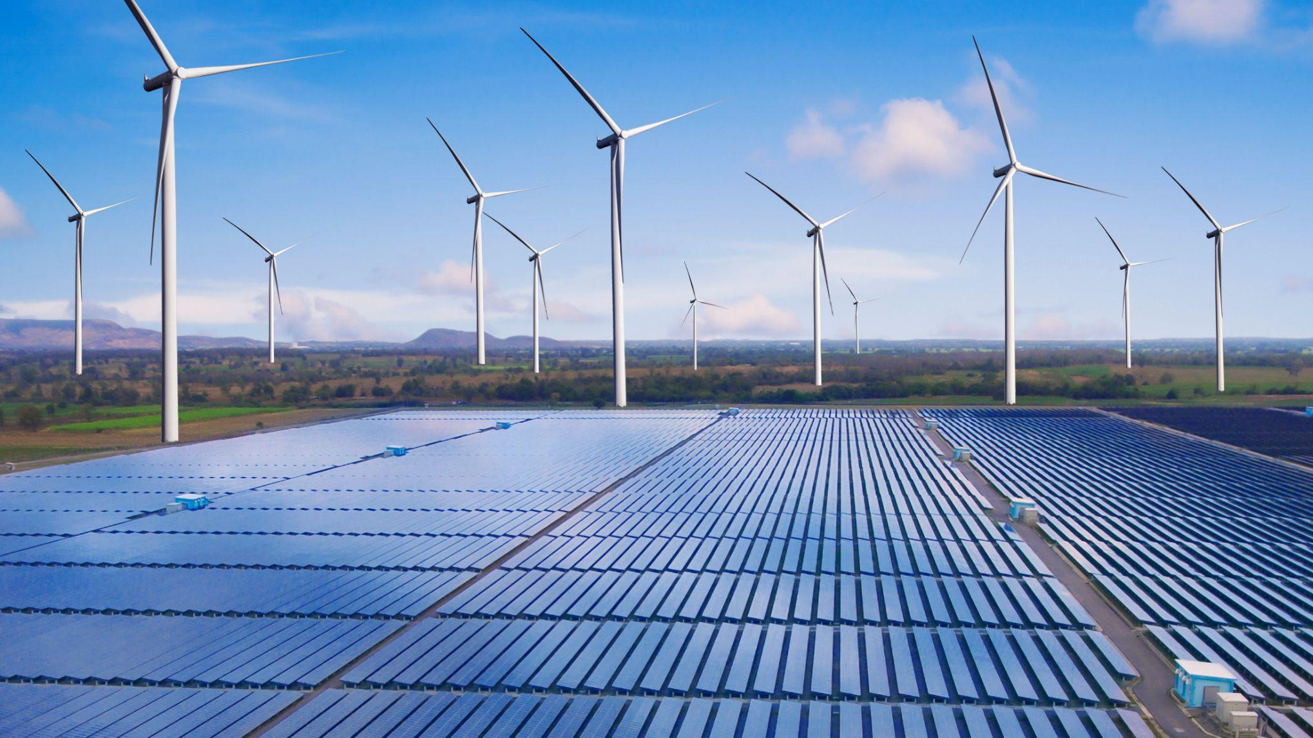
Productivity Enhancement and Investment, Sunrise Opportunities, Energy Transition and Climate Action

Slide 10
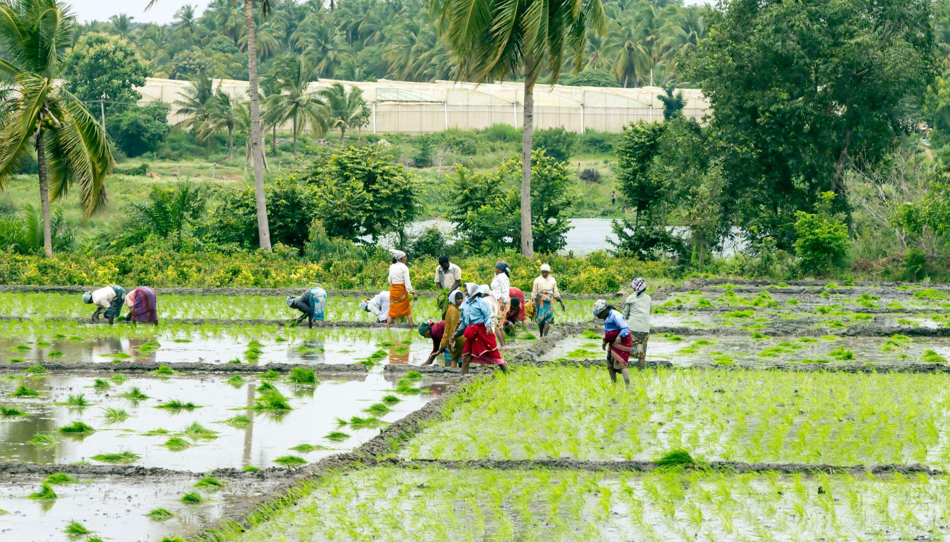
Agriculture
INR 2.37 lakh crore (~US$ 26 billion) direct payment to 1.63 crore (10 million) farmers for procurement of wheat and paddy.
Chemical-free Natural farming to be promoted throughout the county. The initial focus is on farmer’s lands in 5 Km wide corridors along river Ganga.
NABARD to facilitate funds with blended capital to finance startups for agriculture & rural enterprise.
Kisan Drones for crop assessment, digitization of land records, spraying of insecticides and nutrients.
INR 1,400 crore (~US$ 187 million) outlay for implementation of the Ken – Betwa link project.
9.08 lakh (0.91 million) hectares of farmers’ lands to receive irrigation benefits by the Ken-Betwa link project.
"Procurement of wheat in Rabi season 2021-22 and the estimated procurement of paddy in Kharif season 2021-22 will give cover 1208 lakh (~121 million) metric tonnes of wheat & paddy from 163 lakh farmers & INR 2.37 lakh crores (~US$26 billion) will be the direct payment of MSP value to their accounts".

Slide 11
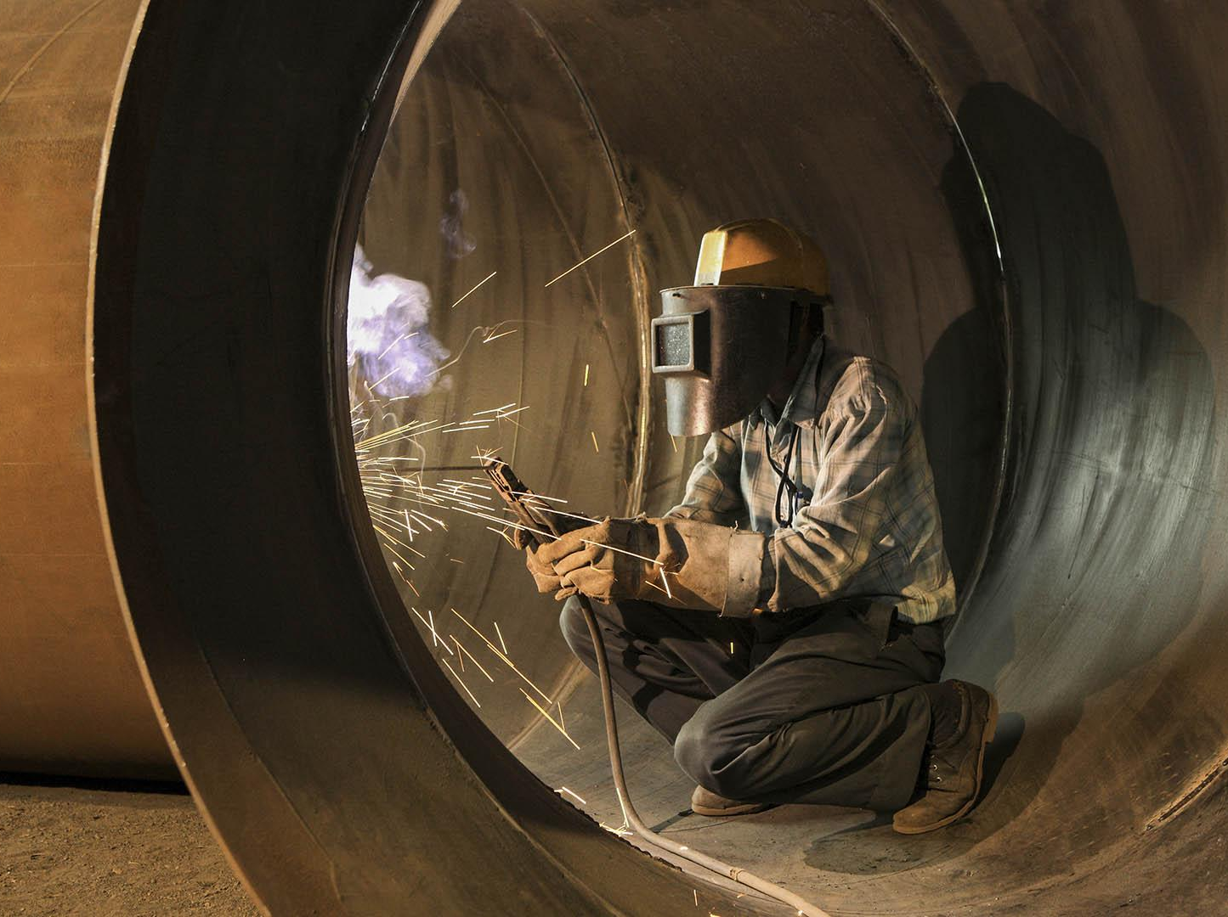
MSME
Udyam (Enterprise), e-shram (for unorganised sector workers), National Career Service (NCS), and Aatmanirbhar Skilled Employee Employer Mapping (ASEEM) portals to be interlinked.
130 lakh (~1 million) MSMEs provided additional credit under Emergency Credit Linked Guarantee Scheme (ECLGS)
ECLGS to be extended up to March 2023.
Guarantee cover under ECLGS to be expanded INR 50,000 crore (~US 6 billion) to the total cover of INR 5 Lakh Crore (~US$ 66 billion)
INR 2 lakh crore (~US$ 26 billion) additional credit for Micro and Small Enterprises to be facilitated under the Credit Guarantee Trust for Micro and Small Enterprises (CGTMSE).
Raising and Accelerating MSME performance (RAMP) programme with an outlay of INR 6000 Crore (~US$ 802 million) to be rolled out.

Slide 12
Skill Development
Digital Ecosystem for Skilling and Livelihood (DESH-Stack e-portal) will be launched to empower citizens to skill, reskill or upskill through online training.
Startups will be promoted to facilitate Drone Shakti and for Drone-As-A-Service (DrAAS)

Slide 13
Health
An open platform for National Digital Health Ecosystem to be rolled out
National Tele Mental Health Programme for quality mental health counselling and care services to be launched.
A network of 23 tele-mental health centres of excellence will be set up, with NIMHANS being the nodal centre and the International Institute of Information Technology-Bangalore (IIITB) providing technical support.
"An open platform for the National Digital Health Ecosystem will be rolled out. It will consist of digital registries of health providers and health facilities, unique health identity and universal access to health facilities."

Slide 14
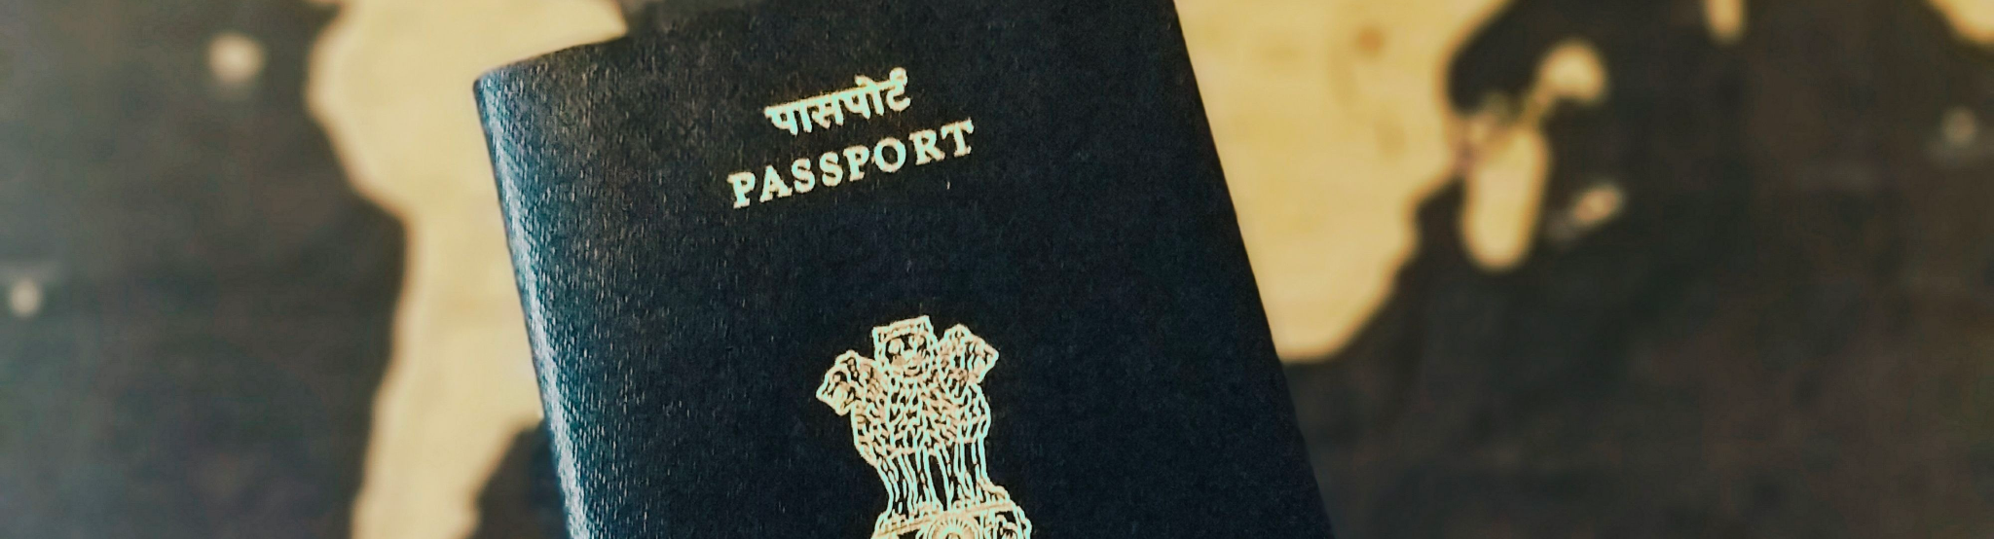
Banking & e-passport
100% of 1.5 lakh (0.15 million) post offices to come on the core banking system.
Scheduled Commercial Banks to set up 75 Digital Banking Units (DBUs) in 75 districts.
e-Passports with embedded chips and futuristic technology to be rolled out.

Slide 15
Telecom Sector
Scheme for design-led manufacturing to be launched to build a strong ecosystem for 5G as part of the Production Linked Incentive Scheme.
Telecommunication and 5G technology will enable growth and offer job opportunities. Required spectrum auctions will be conducted in 2022 to facilitate the rollout of 5G mobile services within 2022-23 by private telecom providers

Slide 16
Export Promotion
Special Economic Zones (SEZ) Act to be replaced with new legislation to enable States to become partners in the Development of Enterprise and Service Hubs.
The new legislation will enable the states to become partners and will cover all large existing and new industrial enclaves to optimally utilise available infrastructure and enhance competitiveness of exports,

Slide 17
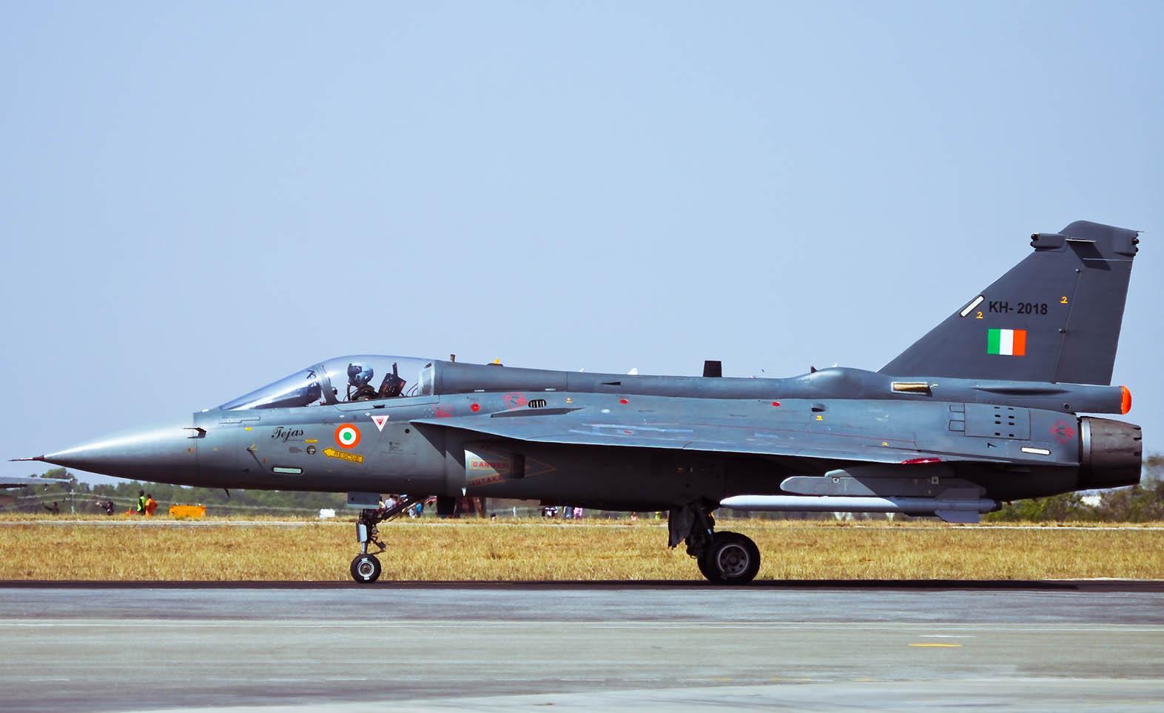
Atmanirbharta (Self Reliance) in Defence
68% of the capital procurement budget earmarked for the domestic industry in 2022-23, up from 58% in 2021-22
Defence R&D to be opened up for industry, startups and academia with 25% of defence R&D budget earmarked
Independent nodal umbrella body to be set up for meeting testing and certification requirements.

Slide 18
Sunrise Opportunities
Government contribution to be provided for R&D in Sunrise sectors like Artificial Intelligence, Geospatial Systems and Drones, Semiconductor and its eco-system, Space Economy, Genomics and Pharmaceuticals, Green Energy, and Clean Mobility Systems.
“The Production Linked Incentive (PLI) schemes have the potential to create 60 lakh (6 million) new jobs and additional production of INR 30 lakh crore (~US$401 billion) during the next five years.”
Sunrise sector is a burgeoning sector in its infancy stage showing promise of a rapid boom. Industries in this sector are characterized by high growth rates, numerous startups, and an abundance of venture capital funding.

Slide 19
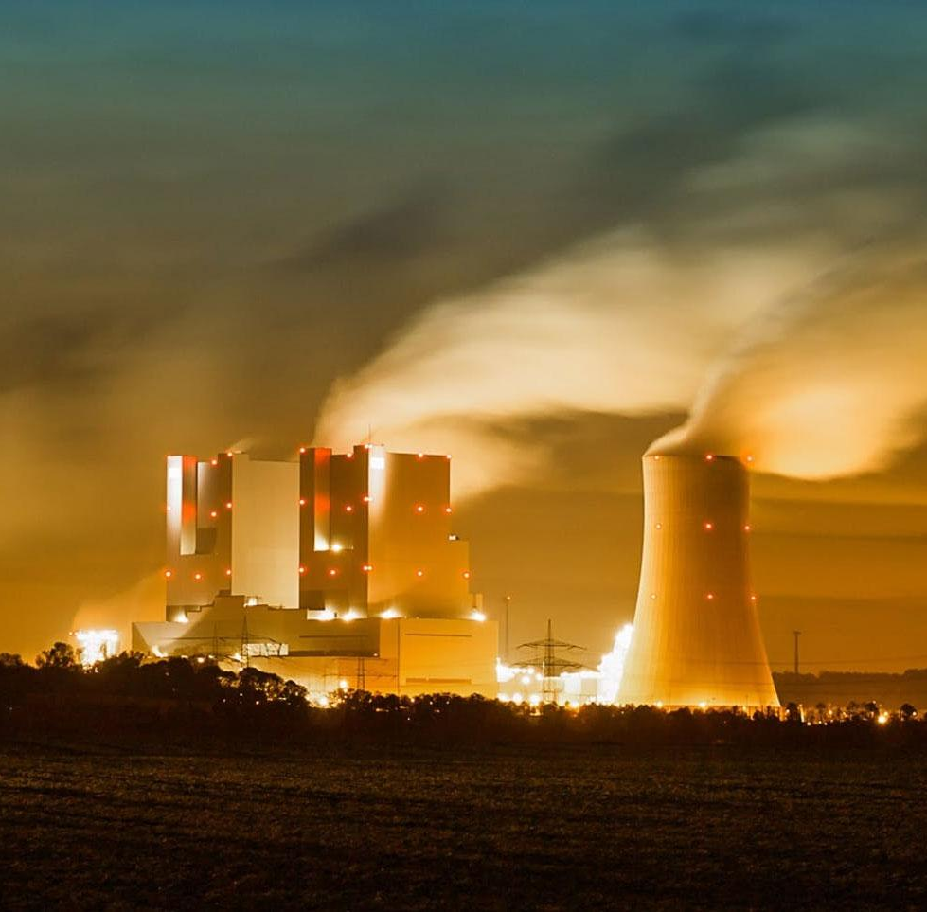
Energy Transition and Climate Action
Additional allocation of INR 19,500 crore (~US$ 2 billion) for Production Linked Incentive for the manufacture of high-efficiency solar modules to meet the goal of 280 GW of installed solar power by 2030
5 to 7% biomass pellets to be co-fired in thermal power plants:
CO₂ savings of 38 million metric tons (MMT) annually,
Extra income to farmers and job opportunities to locals,
Help avoid stubble burning in agriculture fields.
Four pilot projects are to be set up for coal gasification and conversion of coal into chemicals for the industry
Sovereign Green Bonds to be issued for mobilizing resources for green infrastructure.
Data Centres and Energy Storage Systems to be given infrastructure status

Slide 20
Inclusive Development for Aspirational India

Slide 21
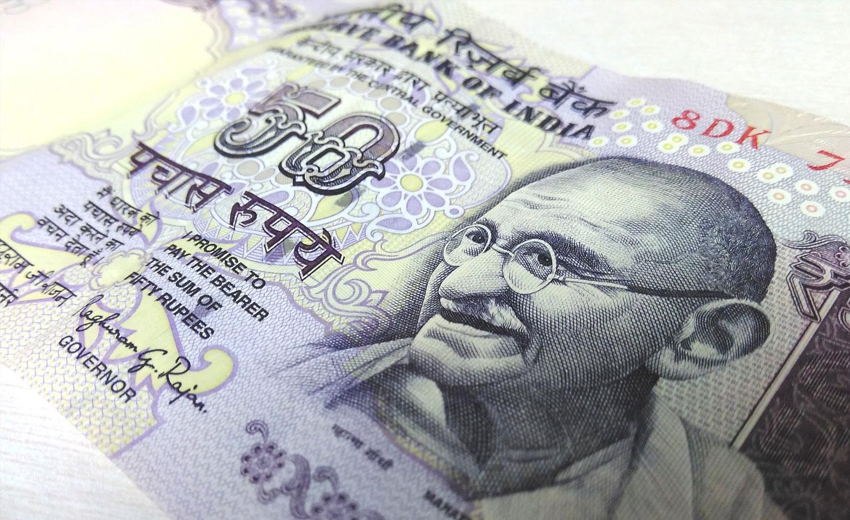
Public Capital Investment
Public investment to continue to pump-prime private investment and demand in 2022-23.
The outlay for capital expenditure stepped up sharply by 35.4% to INR 7.50 lakh crore (~US$ 106 billion) in 2022-23
Outlay in 2022-23 to be 2.9% of GDP.
Effective Capital Expenditure of Central Government estimated at INR 10.68 lakh crore (US$ 147 billion) in 2022-23 which is about 4.1% of GDP.

Slide 22
Digital Rupee
Introduction of Digital Rupee by the Reserve Bank of India starting 2022-23.
The move is seen as a big push for the government's Digital India programme.
A new crypto tax will be introduced under which virtual digital assets will be taxed at 30%

Slide 23
Startups
Existing tax benefits for startups, which were offered redemption of taxes for three consecutive years, has been extended by one more year till March 31, 2023
Funds raised under the co-investment model will be facilitated through NABARD to finance start-ups for agriculture and rural enterprise relevant to the farm produce value chain.
Startups will support Farmer Producer Organizations and provide tech to farmers.

Slide 24
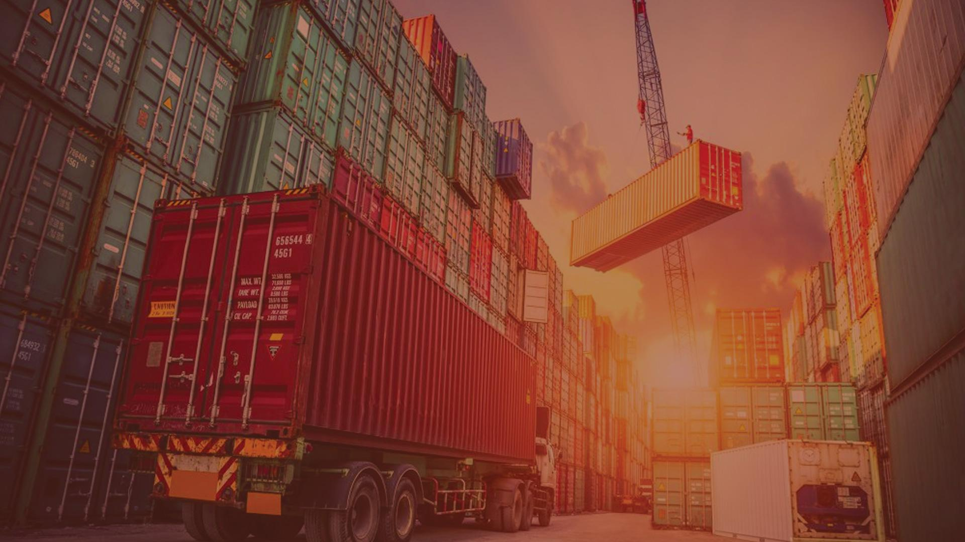
Financing of Investments

Slide 25
Allocation to Existing Schemes: 2022-23
National Health Mission
Program envisages universal access to equitable, affordable, & quality health care services that are accountable to people's needs
INR 37,800 crores (~US 5 billion)
Jal Jeevan Mission Program aimed at providing safe and adequate drinking water through individual household tap connections
INR 60,000 crores (~US 6 billion)
National Education Mission
Program aimed at eradicating illiteracy by imparting functional literacy to non-literates
INR 39,553 crores (~US 5 billion)
Pradhan Mantri Gram Sadak Yojana
Nationwide program to provide good all-weather road connectivity to unconnected villages
INR 19,000 crores (~US 2 billion)
Pradhan Mantri Kisan Samman Nidhi
This government scheme allows all small and marginal farmers to avail upto INR 6,000 (US$ 80) per year as minimum income support
INR 68,000 crores (~US 9 billion)
Aatmanirbhar Bharat Rojgar Yojana
A scheme designed to incentivize the creation of new employment
INR 6,400 crore (~US$ 855 million)
Pradhan Mantri Swasthya Suraksha Yojana
Program aimed at correcting regional imbalances in the availability of affordable and reliable tertiary healthcare services and also to augment facilities for quality medical education in the country
INR 10,000 crore (~US 1.3 billion)

Slide 26
Thank You

